Slide 1
Microprocessor and Computer Architecture
ECSE 201L
L | T | P | Credits
3 | 1 | 2 | 4

Slide 2
Microprocessor Organization
Control
Data
Address
Arithmetic Logic Unit
Memory Management Unit
Bus Management Unit
Control Unit
Decode Unit
Prefetch Unit

Slide 3
Microprocessor Organization
Control
Address
Data
Arithmetic Logic Unit
Memory Management Unit
Bus Management Unit
Control Unit
Decode Unit
Prefetch Unit
Arithmetic Logic Unit: executes all logic and arithmetic operations as specified by the instruction set

Slide 4
Microprocessor Organization
Control
Address
Data
Arithmetic Logic Unit
Memory Management Unit
Bus Management Unit
Control Unit
Decode Unit
Prefetch Unit
Control Unit: contains the microcode that tells the ALU how to function.

Slide 5
Microprocessor Organization
Control
Address
Data
Arithmetic Logic Unit
Memory Management Unit
Bus Management Unit
Control Unit
Decode Unit
Prefetch Unit
Decode Unit: translates instruction into control signals and microcode directions then queues them until requested by the Control Unit.

Slide 6
Microprocessor Organization
Control
Address
Data
Arithmetic Logic Unit
Memory Management Unit
Bus Management Unit
Control Unit
Decode Unit
Prefetch Unit
Prefetch Unit: queues instruction to assure that the microprocessor is in continuous operation.

Slide 7
Microprocessor Organization
Control
Address
Data
Arithmetic Logic Unit
Memory Management Unit
Bus Management Unit
Control Unit
Decode Unit
Prefetch Unit
Memory Management Unit: converts internal logic addresses into external memory addresses.

Slide 8
Microprocessor Organization
Control
Address
Data
Arithmetic Logic Unit
Memory Management Unit
Bus Management Unit
Control Unit
Decode Unit
Prefetch Unit
Bus Management Unit: manages the flow of information between the microprocessor and data storage locations (main disk, CD-ROM, etc.) and peripherals ( printer, monitor, etc.)

Slide 9
Computer Arithmetic

Slide 10
Chapter Organization
Representing negative numbers
Integer addition and subtraction
Integer multiplication and division
Floating point operations

Slide 11
General concept
Decimal addition
(carry) 1_ 19
+ 7
26
Binary addition
( carry) 111_
10011
+ 111
11010
16+8+2 = 26

Slide 12
Realization with adders
Simplest solution is a battery of full adders
o s3
s2
s1
s0
x3 y3
x2 y2
x1 y1
x0 y0

Slide 13
Observations
Adder add four-bit values
Output o indicates if there is an overflow
A result that cannot be represented using 4 bits happens when x + y > 15
Operation is slowed down by carry propagation
Faster solutions (not discussed here)

Slide 14
Signed and unsigned additions
Unsigned addition in 4-bit arithmetic
( carry) 11_
1011
+ 0011
1110
11 + 3 = 14 (8 + 4 + 2)
Signed addition in 4-bit arithmetic
( carry) 11_
1011
+ 0011
1110
-5 + 3 = -2

Slide 15
Examples (using 5-bit signed numbers)
Case 1: (+7) + (+4)
+7=00111
+4=00100
00111+00100 = 01011
(Result: +11
Case 2: (-7) + (-4)
-7=11001 (2's complement of 7)
-4=11100 (2's complement of 4)
11001+11100 = 110101
Discard carry-out:
Result: -11 (2's complement, Sign bit 1)
Case 3: (-7) + (+4)
-7=11001
+4=00100
00111 + 00100 = 11101 (-3 sign bit 1)

Slide 16
Signed and unsigned additions
Same rules apply even though bit strings represent different values
Sole difference is overflow handling

Slide 17
Overflow handling (I)
No overflow in signed arithmetic
( carry) 111_
1110
+ 0011
0001
-2 + 3 = 1 (correct)
Signed addition in 4-bit arithmetic
( carry) 1__
0110
+ 0011
1001
6 + 3 ≠ -7 (false)

Slide 18
Overflow handling (II)
In signed arithmetic an overflow happens when
The sum of two positive numbers exceeds the maximum positive value that can be represented using n bits: 2^{n – 1} – 1
The sum of two negative numbers falls below the minimum negative value that can be represented using n bits: – 2^{n – 1}

Slide 19
Example
Four-bit arithmetic:
Sixteen possible values
Positive overflow happens when result > 7
Negative overflow happens when result < -8
Eight-bit arithmetic:
256 possible values
Positive overflow happens when result > 127
Negative overflow happens when result < -128

Slide 20
Overflow handling (III)
MIPS (Million Instructions per second) architecture handles signed and unsigned overflows in a very different fashion:
Ignores unsigned overflows
Implements modulo 2^{n} arithmetic
Generates an interrupt whenever it detects a signed overflows
Lets the OS handled the condition
1111 (4 bits)
Overflow in 3 bit representation
Perform modulo 2
Result will be 111
(no overflow in 3 bit)
Example: Adding two positive numbers
Adding 5 + 3 should equal 8, which is outside the range of -8 to 7.
5 in 4-bit binary is 0101
3 in 4-bit binary is 0011
0101 (5) + 0011 (3) ------- 1000
(-8 in two's complement)
*The result is 1000, which the computer interprets as -8 (a negative number). Since two positive numbers were added to produce a negative result, an overflow exception is raised in MIPS.
Example: Adding two negative numbers
Adding -4 + -5 should equal -9, which is outside the range of -8 to 7.
-4 in 4-bit binary is 1100
-5 in 4-bit binary is 1101
1100 (-4) + 1101 (-5) ------- 1 0111
(7 in two's complement)
*The result in 4 bits is 0111, which the computer interprets as 7 (a positive number). Since two negative numbers were added to produce a positive result, an overflow exception is raised.

Slide 21
Subtraction
Can be implementing by
Specific hardware
Negating the subtrahend

Slide 22
Negating a number
Toggle all bits then add one

Slide 23
In 4-bit arithmetic (I)
0001 | 1 | 1110 | +1 = 1111 | -1
0010 | 2 | 1101 | +1 = 1110 | -2
0011 | 3 | 1100 | +1 = 1101 | -3
0100 | 4 | 1011 | +1 = 1100 | -4
0101 | 5 | 1010 | +1 = 1011 | -5
0110 | 6 | 1001 | +1 = 1010 | -6
0111 | 7 | 1000 | +1 = 1001 | -7

Slide 24
In 4-bit arithmetic (II)
1001 | -7 | 0110 | +1 = 0111 | 7
1010 | -6 | 0101 | +1 = 0110 | 6
1011 | -5 | 0100 | +1 = 0101 | 5
1100 | -4 | 0011 | +1 = 0100 | 4
1101 | -3 | 0010 | +1 = 0011 | 3
1110 | -2 | 0001 | +1 = 0010 | 2
1111 | -1 | 0000 | +1 = 0001 | 1

Slide 25
Addition and Subtraction
Let us consider the magnitude of the two numbers as A and B.
when the signed numbers are added or subtracted, there are eight different conditions to consider, depending on the sign of the numbers and the operation performed.
These conditions are listed in the first column of the table below (next slide).
The other column in the table show the actual operation to be performed with the magnitude of the numbers.

Slide 26
Addition and Subtraction…
Operation | ADD Magnitudes | SUBTRACT Magnitudes
 |  | A > B | A < B | A = B
(+A) + (+B) | + (A + B)
(+A) + (-B) |  | + (A – B ) | – (B – A ) | + (A – B )
(-A) + (+B) |  | – (A – B ) | + (B – A ) | + (A – B )
(-A) + (-B) | – ( A + B)
(+A) - (+B) |  | + (A – B ) | – (B – A ) | + (A – B )
(+A) - (-B) | + (A + B)
(-A) - (+B) | – ( A + B)
(-A) - (-B) |  | – (A – B ) | + (B – A ) | + (A – B )
The last column is required to prevent negative zero. In other words, when two equal numbers are subtracted, the result should be +0 not -0.

Slide 27
Addition and Subtraction…
Addition (subtraction) algorithm:
When the signs of A and B are identical (different), add the two magnitude and attach the sign of A to the result.
When the sign of A and B are different (identical), compare the magnitudes.

Slide 28
Addition and Subtraction…
Hardware Implementation
To implement the two arithmetic operations with hardware, it is first required that the two numbers be stored in registers.
Let A and B be two registers that hold the magnitude of the numbers, and A_{s} and B_{s} be two flipflops that hold the corresponding signs.
The results of the operation may be transferred to a third register however, a saving achieved if the result is transferred into A and A_{s}.
Thus A and A_{s} together form an Accumulator register.
In a computer's central processing unit (CPU), the accumulator is a register in which intermediate arithmetic and logic results are stored.

Slide 29
Addition and Subtraction…
Hardware Implementation…
Consider now the hardware implementation of the algorithms above.
First, a parallel adder is needed to perform the micro operation A+B.
Second, comparator circuit is needed to establish if A>B, A=B, or A<B.
Third, two parallel subtractor circuits are required to perform the micro operation A-B and B-A.
The sign relationship can be determined from an XOR gate with A_{s} and B_{s} as inputs.

Slide 30
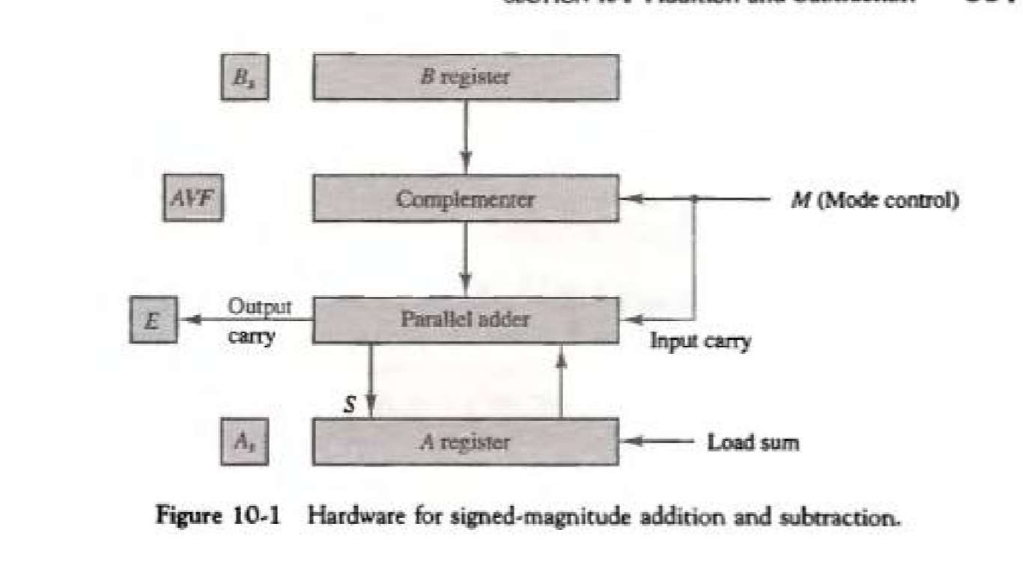
Addition and Subtraction…
The output carry is transferred to flip-flop E.
The complementor consists of exclusive-OR gates and the parallel adder consists of full adder circuit.

Slide 31
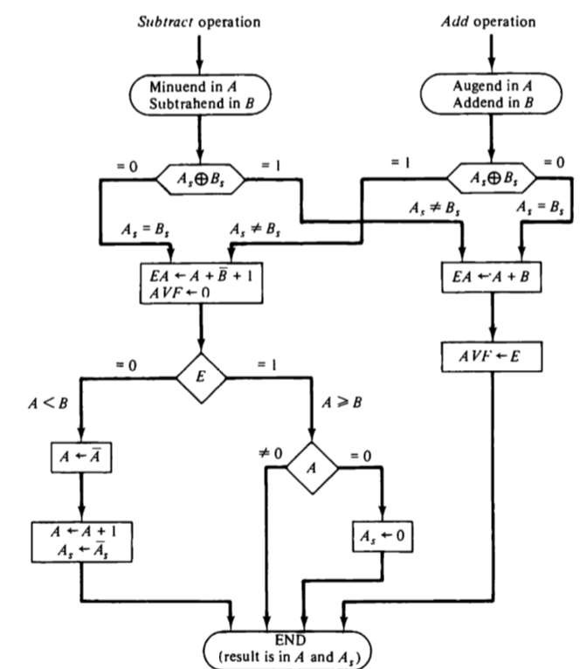
Addition and Subtraction…
Hardware Algorithm

Slide 32
Addition and Subtraction…
The two signs A_{s} and B_{s} are compared by an exclusive-OR gate.
For an add operation, identical signs dictate that the magnitudes be added, for subtract operation different signs dictate that the Magnitudes be added. The magnitudes are added with a micro operation E A <- A+B. Where E A is a register that combines E and A.
For A, 0 indicates that A < B, for this case it is necessary to take the 2’s complement of the value in A. This operation can be done with one micro operation A <- Ā+1.
However, we assume that A register as circuits for microoperations complement and increment, so the 2’s complement is obtain from these two micro operations.
The value in AVF provides an overflow indication. The final value of E is immaterial.

Slide 33
Addition and Subtraction…
Addition and Subtraction with signed 2’s complement data
The left most bit of binary number represents the sign bit; 0 for positive and 1 for negative. If the sign bit is 1, the entire number is represented in 2’s complement form.
The addition of two numbers in signed-2’s complement form consists of adding the number with the sign bits treated the same as the other bits of the number.
A carry out of the sign bit position is discarded .

Slide 34
Addition and Subtraction…
Addition and Subtraction with signed 2’s complement data…
The subtraction consists of first taking the 2’s compliment of the subtrahend and then adding it to the minuend.
When two numbers of n digits each are added and the sum occupies n+1 Digits, we say that an overflow occurred.
When the two carries are applied to an exclusive-OR gate, the overflow is detected when the output of the gate is equal to 1.

Slide 35
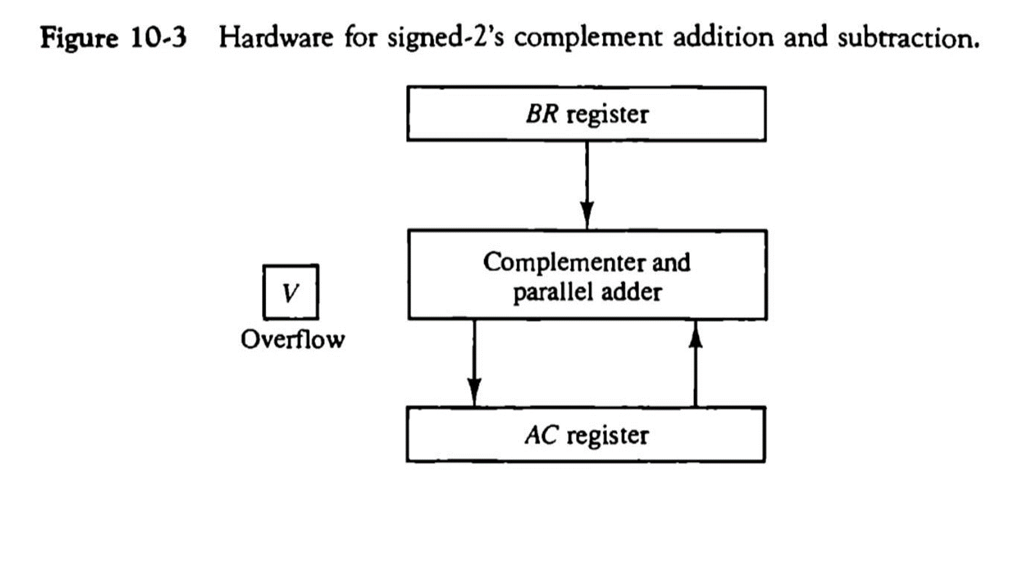
Addition and Subtraction…
Addition and Subtraction with signed 2’s complement data…
The left most bit in AC and BR represents the sign bits of the numbers.
The over flow flip-flops V is set to 1 if there is an overflow. The output carry in this case is discarded.

Slide 36
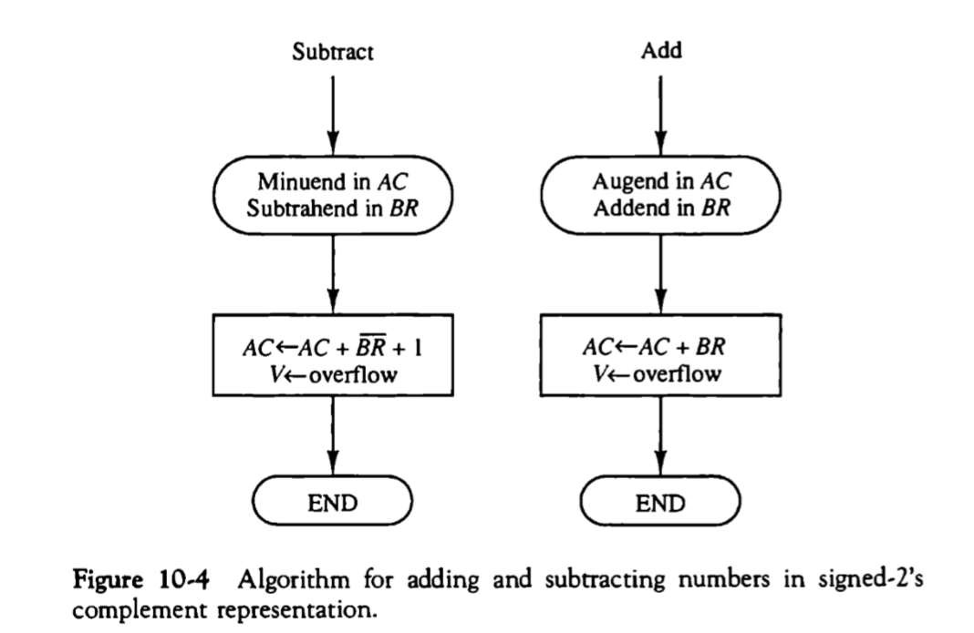
Addition and Subtraction…
Addition and Subtraction with signed 2’s complement data…
The sum is obtained by adding the contents of AC and BR (including their sign bits). The overflow bit V is set to 1 if the ex-OR of the last two carries is 1, and it is cleared to 0 otherwise.

